Slide 1

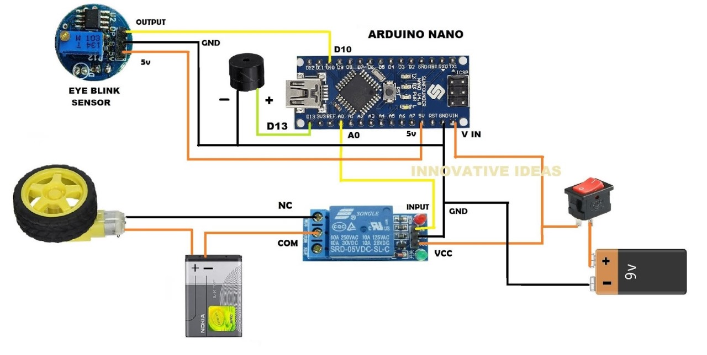
Anti Sleeping Alarm for Drivers

Slide 2

INTRODUCTION
The drowsiness detection system is capable of detecting drowsiness quickly. The system
Can differentiate normal eye blink and drowsiness can prevent the driver from entering
The state of sleepiness while driving. The system works well irrespective of driver wearing
Spectacles and under low light conditions also. During monitoring, the system is able to decide
If the eyes are closed are open. When the eyes have been closed for a long a warning signal is
Issued. The ultimate goal of the system is to check the drowsiness condition of driver. Based on
The eyes movements of the driver, the drowsiness is detected and according to eye blink the
Alarm will be generated to alert the driver and to reduce the speed of the vehicle along with the
In detection of parking light. By doing this, many accidents will be reduced and provide safety
To the driver and the vehicle. A system that is driver safety is presented only in luxurious car
Using eye detection driver security and safety can be implemented in normal car
Also.

Slide 3
IR SENSOR
ARDUINO NANO
POWER
SUPPLY
PIEZO-BUZZER
BLOCK DIAGRAM
VIBRATION
MOTOR

Slide 4
ARDUINO
NANO
It Is Microcontroller Board. It Is Used
for technical Support, where we dump a code into it and it works as a controller or function.
The Operating Voltage of 5v However the input voltage can vary from 7to 12v.

Slide 5
It is a electronic device used to detect some object
near-by surrounding.
It detect the movement of the
object .
In this project we used IR sensor
as an input to detect the movement of eye-blink.
IR
SENSOR

Slide 6
PIEZO-
BUZZER
A piezo Buzzer is used to get output of the execute Program and any error occurs in it an immediate buzzer Is generated

Slide 7
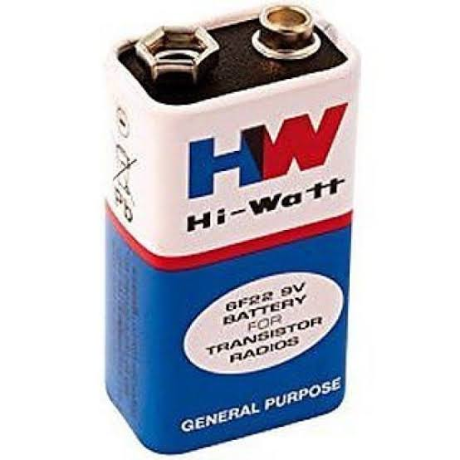
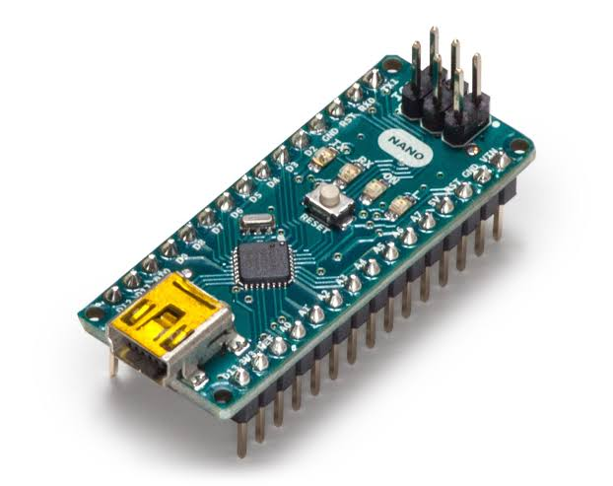
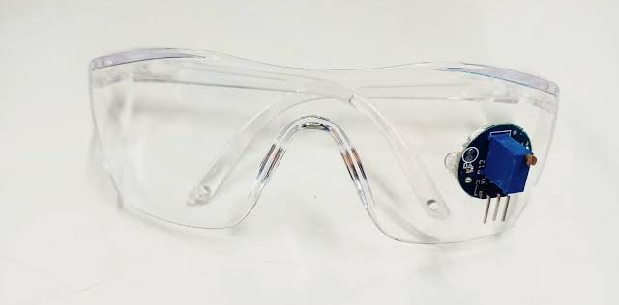
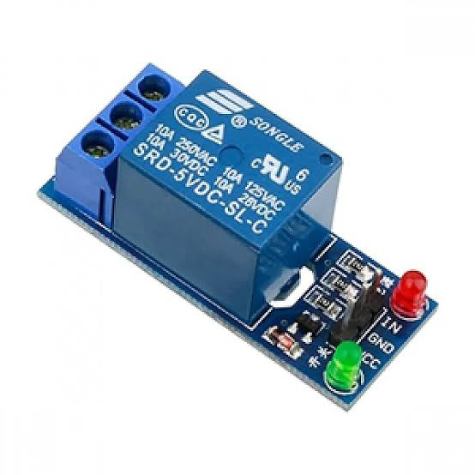
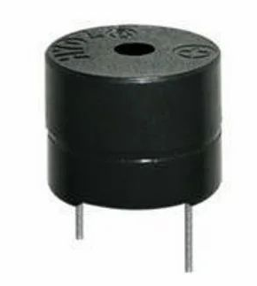
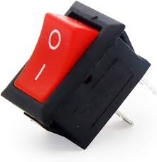
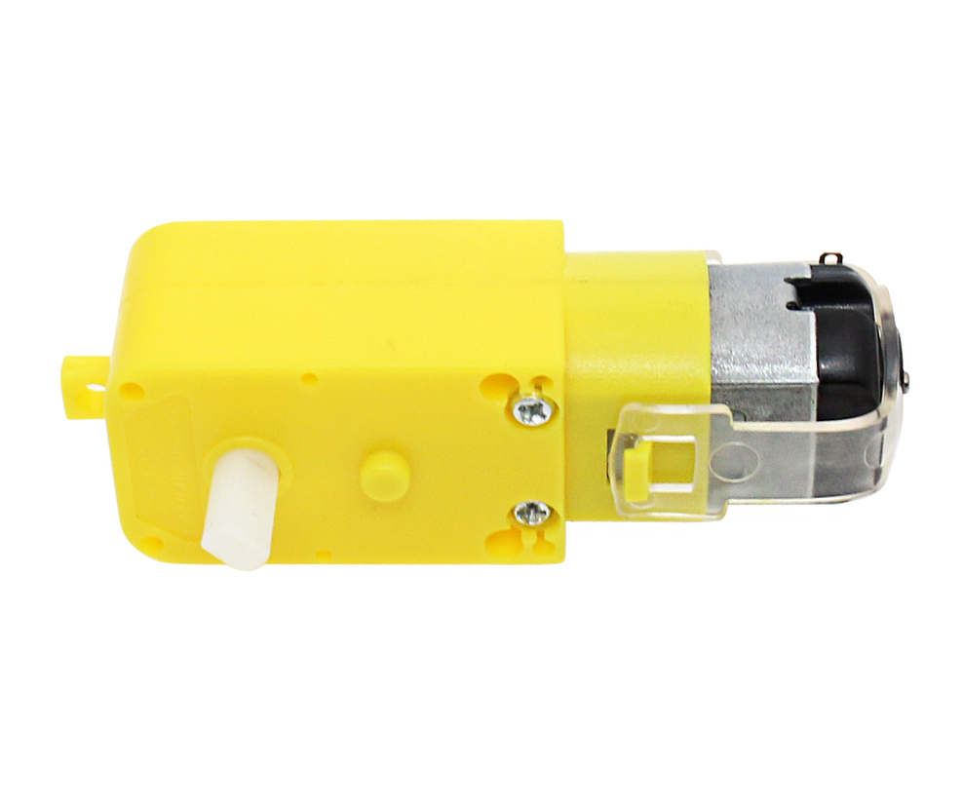
HARDWARE COMPONENTS

Slide 8
A 9V battery is an electric battery that supplies a nominal voltage of 9V.
Actual voltage measures 7.2 to 9.6V. Here, we use 9V battery for power supply to execute the working process.

Slide 9
The Nano board is designed in such a way that the pins are breadboard friendly so that you can easily mount it on one of your DIY projects. Overall, the Arduino Nano is a very good alternative to the mighty Arduino UNO and is available at a lower price. Personally speaking, I suggest
Arduino over UNO.

Slide 10
The eye blink system comes with an IR sensor mounted on glasses which the user can wear
like regular glasses, shown in the picture below.
Eye blink Sensor is a relatively simple sensor used to detect eye blinks.
It uses a simple infrared sensor to detect if the
person's eye is closed and the corresponding data
received can further be processed by any logic
as required for the application.

Slide 11
The piezo buzzer produces sound based on reverse of the piezoelectric effect.
The generation of pressure variation or strain by the application of electric potential
across a piezoelectric material is the underlying principle.
These buzzers can be used alert a user of an event corresponding to a switching action,
counter signal or sensor input.
They are also used in alarm circuits.
The buzzer produces a same noisy sound irrespective of the voltage
variation applied to it. It consists of piezo crystals between two conductors.
When a potential is applied across these crystals, they push on one conductor and
pull on the other. This, push and pull action, results in a sound wave.
Most buzzers produce sound in the range of 2 to 4 kHz.

Slide 12
SPST Single pole single throw switch is nothing but a simple
two-terminal switch which help us to disconnect the one terminal
to another terminal (vice versa– ON or OFF operation).

Slide 13
IR sensor is an electronic device that emits the light in order to sense some object of the surroundings.
An IR Sensor can measure the heat of an object as well as detects the motion.
Usually, in the Infrared spectrum all the objects radiate some form of thermal radiation.
These types of radiations are invisible to our eyes, but infrared sensor can detect these radiations.
The emitter is simply an IR LED and the detector is simply an IR photodiode.
Photodiode is sensitive to IR light of the same wavelength which is emitted by the IR LED.
When IR light falls on the photodiode, the resistances and
the output voltages will change in proportion to the magnitude
of the IR light received.

Slide 14
This is the micro vibration motor, as you can see it has two wires red and black.
Red is the positive wire while black is the ground wire. The working voltage
of the vibration motor is 2 to 5 volts.
The rated voltage is 3.7 volts and the current is .07 amps which is equal
to 70milli-amps. As you can see the vibration motor has small
thin wires due to which it’s really hard to interface this with the Arduino,
so I decided to fix the vibration motor on a small PCB board.

Slide 15
Working
CONCLUSION

Slide 16
Working
The project is used to detect the Eye-blink or closing the eyes of a person, if eyes closed for a while.
The buzzer automatically turns ON, when the person come back to his normal State.
The buzzer goes OFF.
Given below Figure shows the working of the project.

Slide 17
This Project “ANTI-SLEEP ALARM FOR DRIVERS” is successfully designed, and tested and demo unit is fabricate.
Whenever a driver asleep due to drowsiness, the buzzer continuously starts beeping unless the driver gets back to his/her normal position.
The ultimate goal of the system is to prevent the road accident, where the values measured in life.
CONCLUSION

Slide 18
ADVANTAGES
It is used to avoid the accidents.
It is more-efficient and simple to use.
Using this Device helps the driver to wake up when he/she asleep while Driving.
Affordable Cost and Portable Size.
DISADVANTAGES
APPLICATIONS

Slide 19
DISADVANTAGES
Device may not work when the system circuitry fails.
Yawning repeatedly or rubbing the eyes may get the circuit ON.
ADVANTAGES
APPLICATIONS

Slide 20
APPLICATIONS
Eyelid distance tracking to detect the Sleepiness.
Sleepiness detection is Efficient and alarms will generate only when demanded (while in asleep).
This can be used in high-end manufacturing cars to prevent accidents.
Not only for Drivers but also, the device is used in number of ways like,
ATM Guard Security, Military Base Security, bank Security and so on.
ADVANTAGES
DISADVANTAGES

